Slide 1
SQL For Data Science MOOCS
By: Kunal Keshan
Reg No: RA2011004010051

Slide 2

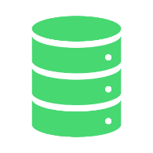


Course Details
Course Platform:
Coursera
Course Title:
SQL for Data Science
Offered by:
University of California Davis
Duration:
4 weeks

Slide 3
About this Course
Data scientists are in high demand, with a median base salary of $110,000 and thousands of job openings at a time.
To be a good data scientist, you need to be skilled in SQL, the standard language for communicating with database systems.
This course is designed for beginners without any prior knowledge or skills in SQL, and it will gradually build their foundation in SQL and data analysis.
The course covers topics like creating tables, moving data, using common operators, and shaping data for targeted analysis purposes.
A simple text editor is recommended for the final project, but there are no specific prerequisites or software requirements to take this course.

Slide 4
Course instructor
Taught by:Sadie St. Lawrence, Founder and CEO Women in Data (WID) Sadie St. Lawrence is the Founder and CEO of Women in Data, a national
non-profit organisation focused on increasing diversity, creating
connections, and driving meaning from data.
Sadie brings a unique combination of technical expertise, analytics
management experience and an ability to lead organisational change through
compassion and problem-solving.
She has trained over 70,000 people in Data Science and is an advocate for
democratising artificial intelligence and helping people transition into the 4th
industrial revolution.
Sadie is on a mission to bring compassion to business and finds joy inhelping
individuals become liberated and find their own personal journey to a more
authentic and connected life.
In her free time, Sadie enjoys traveling, skiing, paddle boarding, yoga, and
authentic conversations

Slide 5

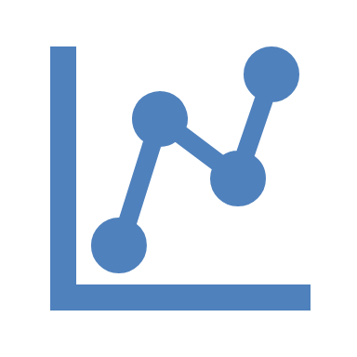
Introduction
Data collection has increased exponentially, so has the need for people skilled at using and interacting with data; to be able to think critically, and provide insights to make better decisions and optimize their businesses.
This is a data scientist, “part mathematician, part computer scientist, and part trend spotter”. The skills necessary to be a good data scientist include being able to retrieve and work with data, and to do that you need to be well versed in SQL, the standard language for communicating with database systems.

Slide 6
History
The SQL programming language was developed in the 1970s by IBM
researchers Raymond Boyce and Donald Chamberlin. The programming language,
known then as SEQUEL, was created following Edgar Frank Codd's paper, “A Relational
Model of Data for Large Shared Data Banks,” in 1970. It wasn’t until several years later,
however, that the SQL language was made publicly available. In 1979, a company called “Relational Software”, which later became Oracle, commercially released its own version of SQL, called Oracle V2. Since then, the American National Standards Institute (ANSI) and the International Organization for Standardization have deemed SQL the standard language in relational database communication.
While major SQL vendors modify the language to their desires, most base their SQL programs on the ANSI-approved version.

Slide 7
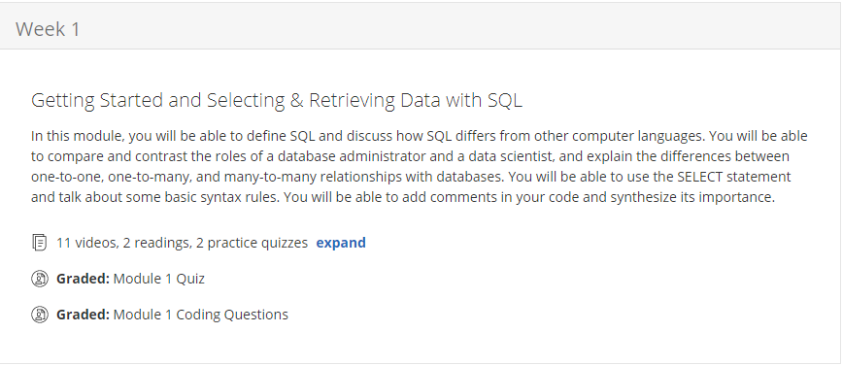
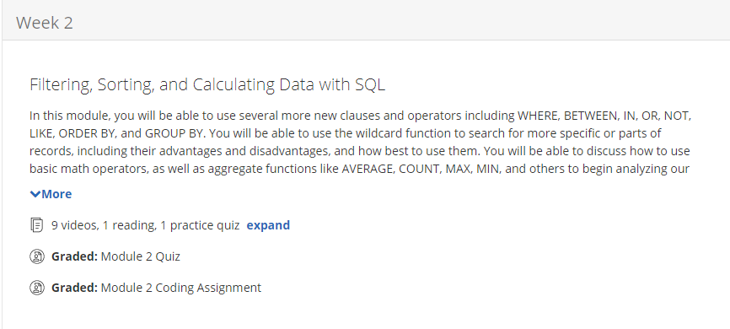
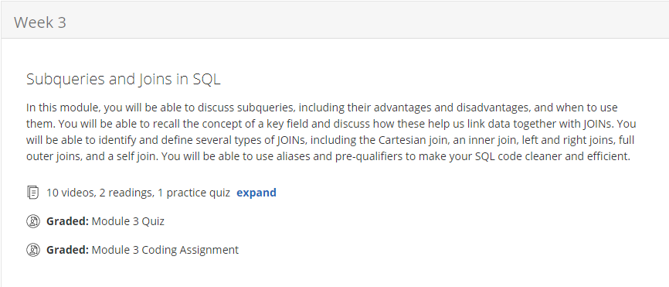
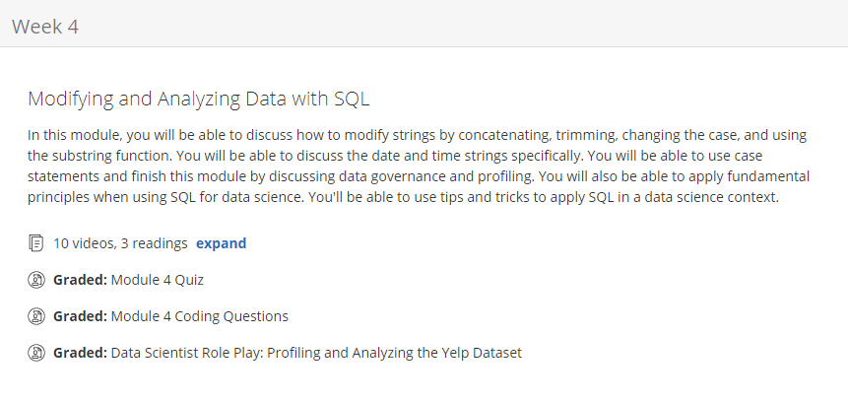
Course Overview

Slide 8
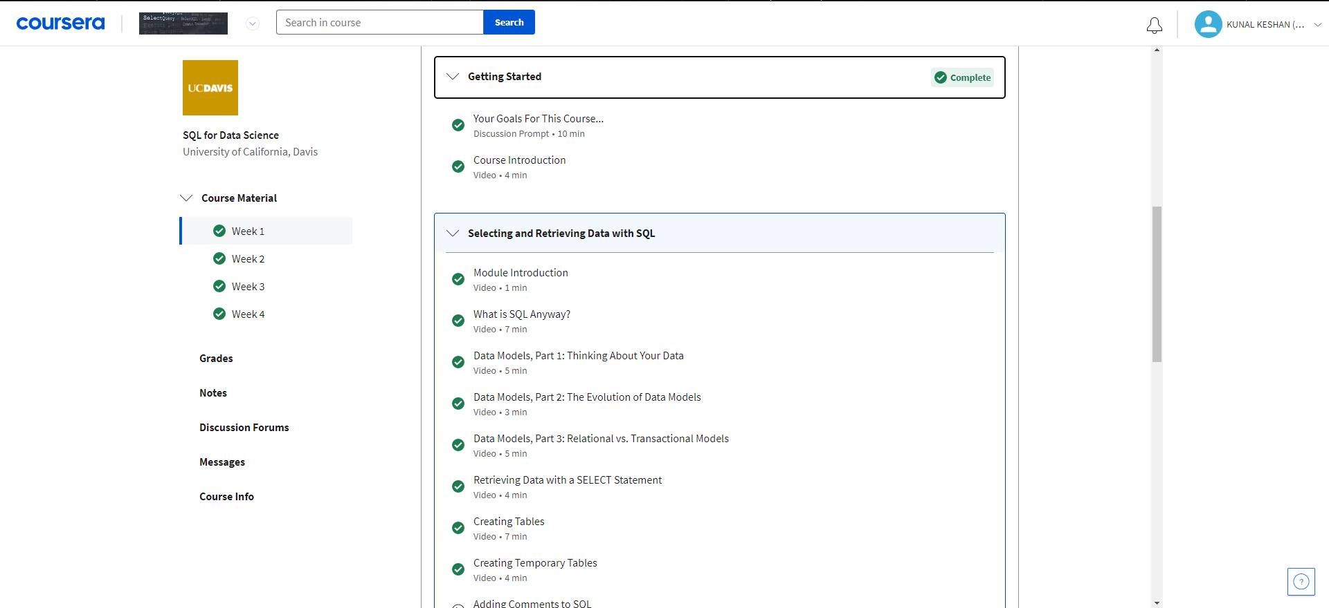
Week 1

Slide 9
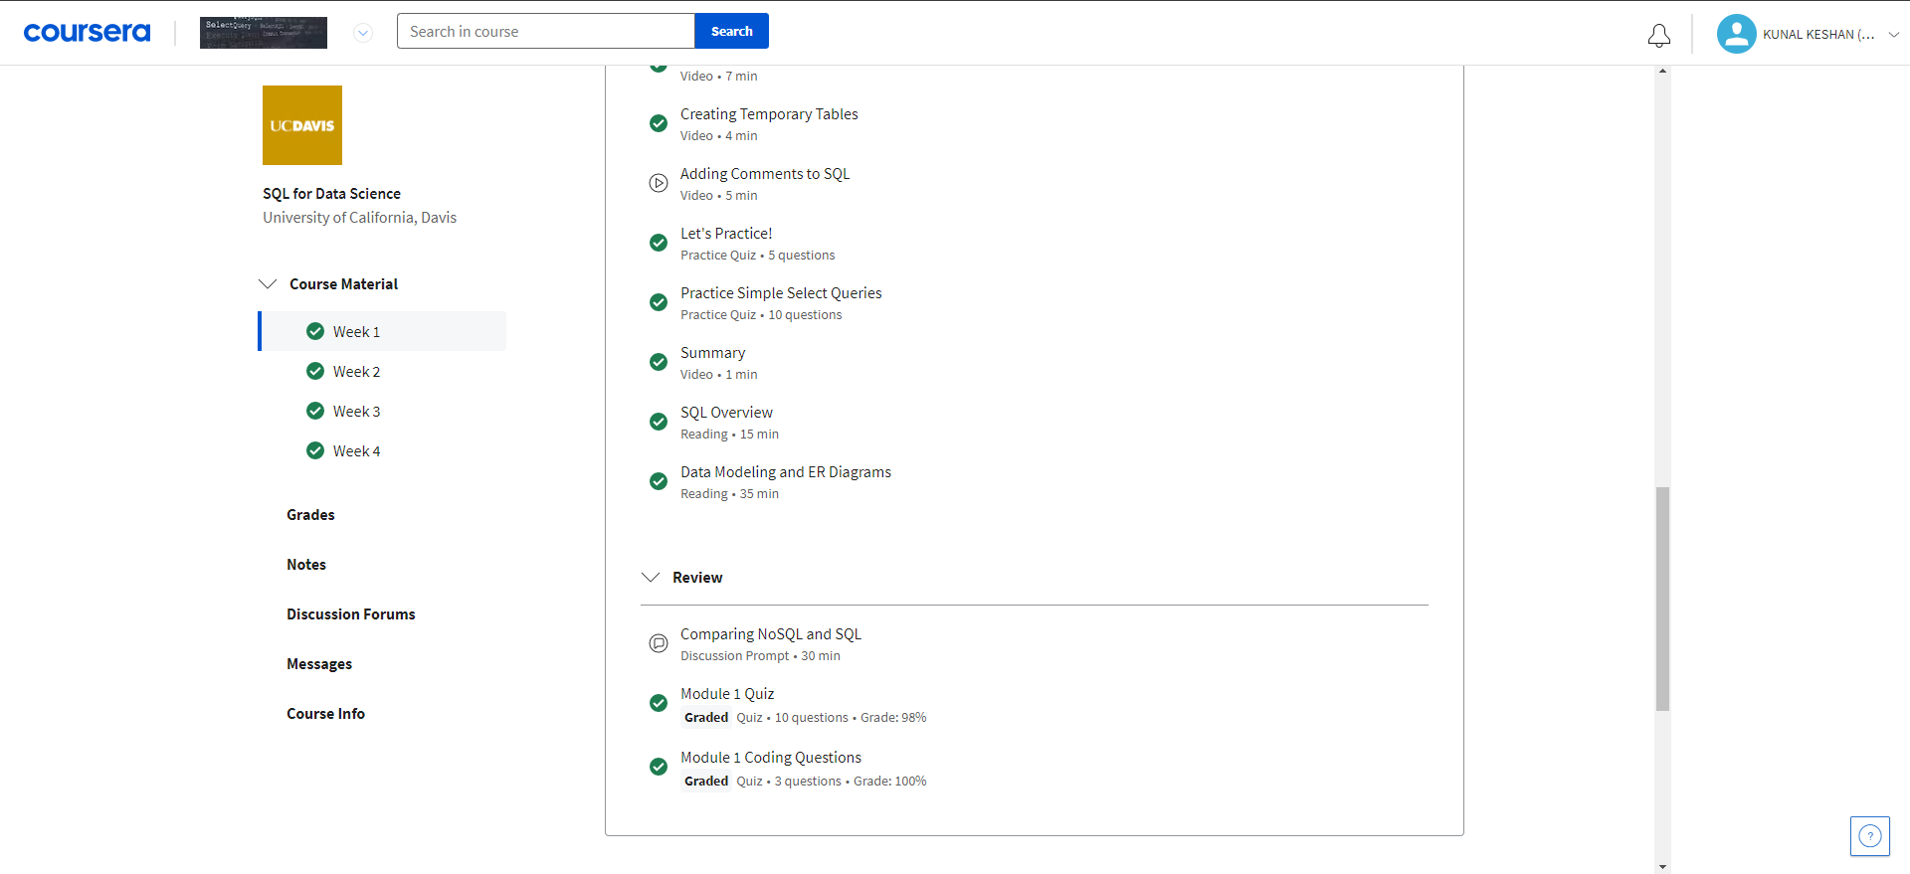
Week 1

Slide 10
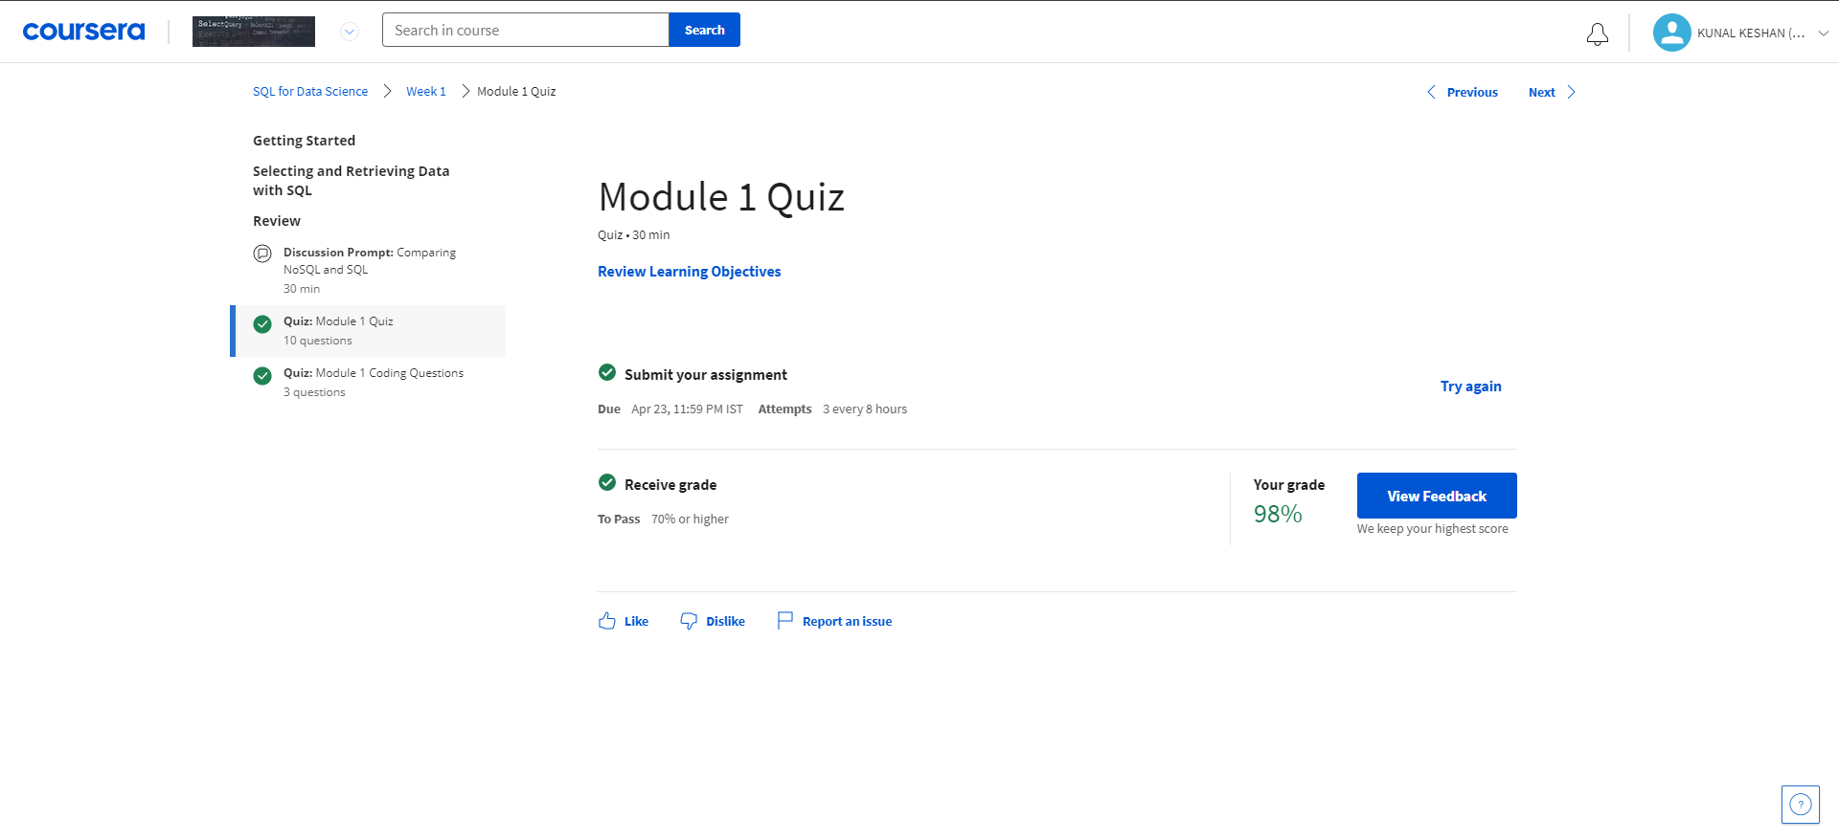
Module 1 Quiz

Slide 11
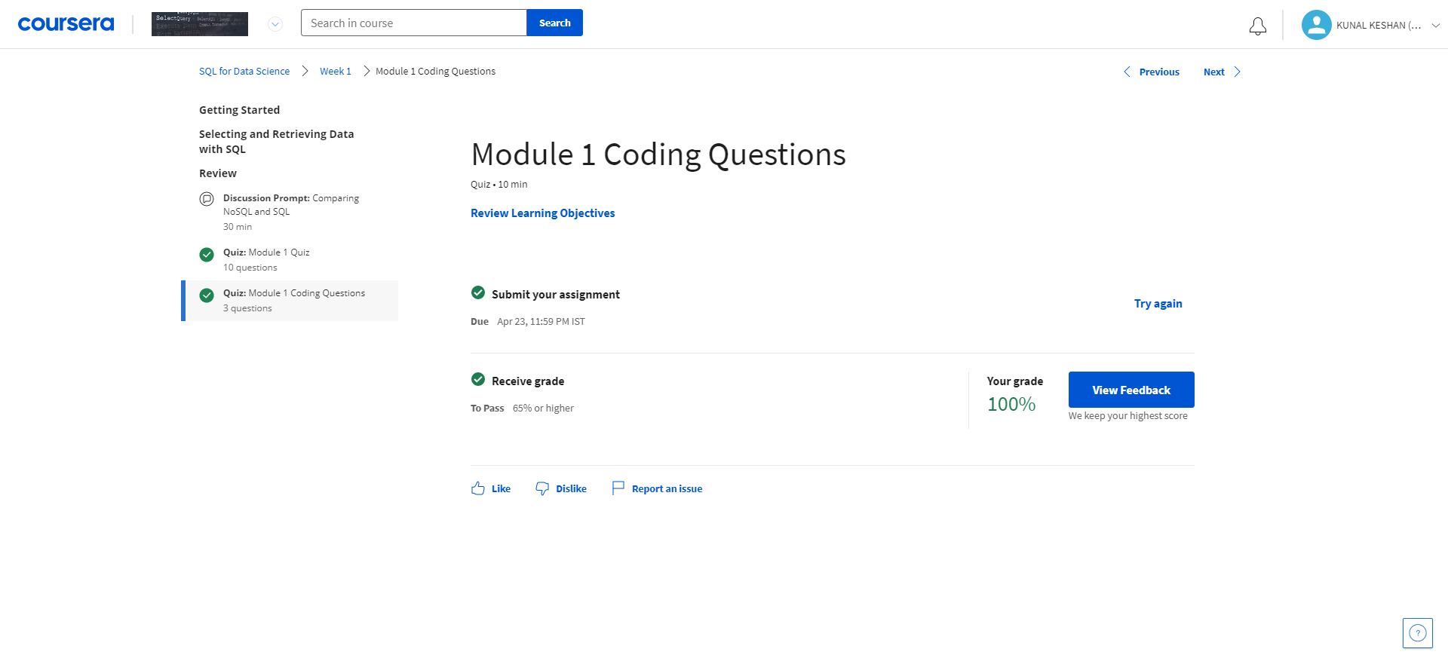
Module 1 Coding Assignment

Slide 12
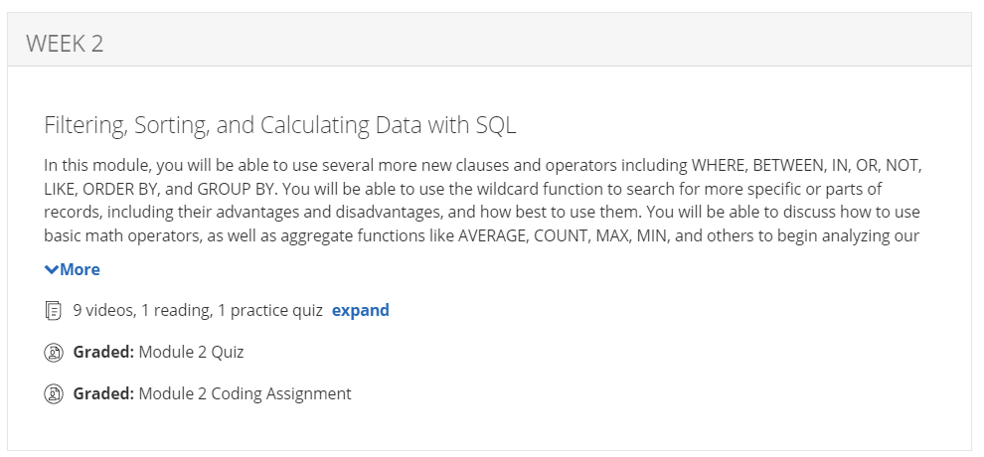
Week 2

Slide 13
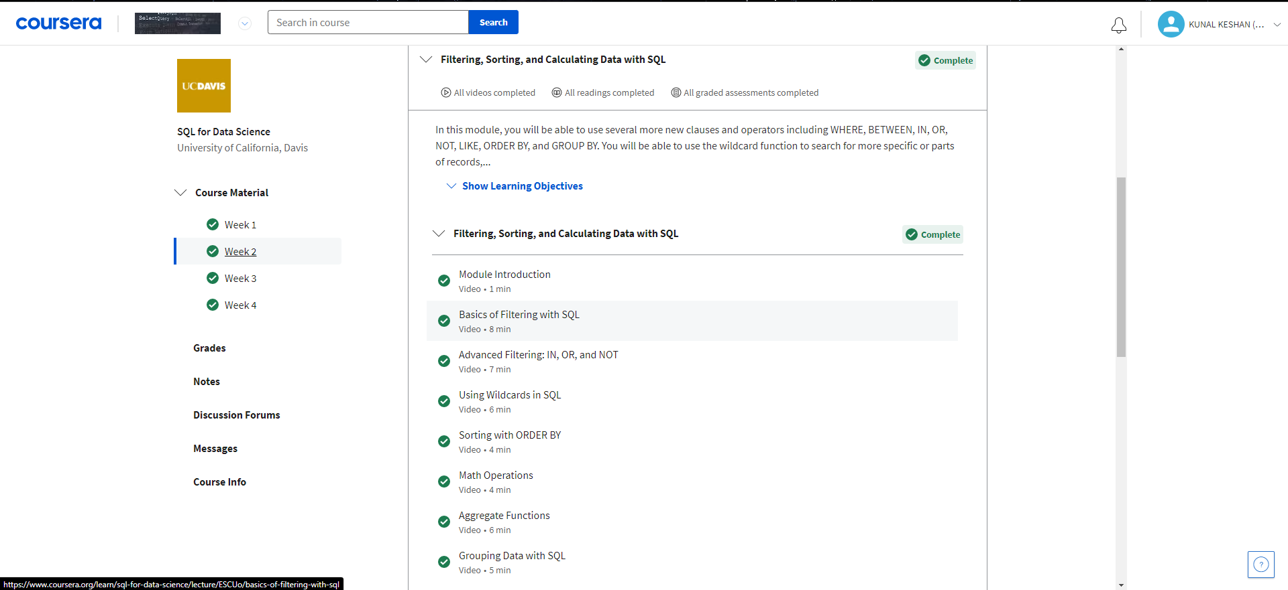
Week 2

Slide 14
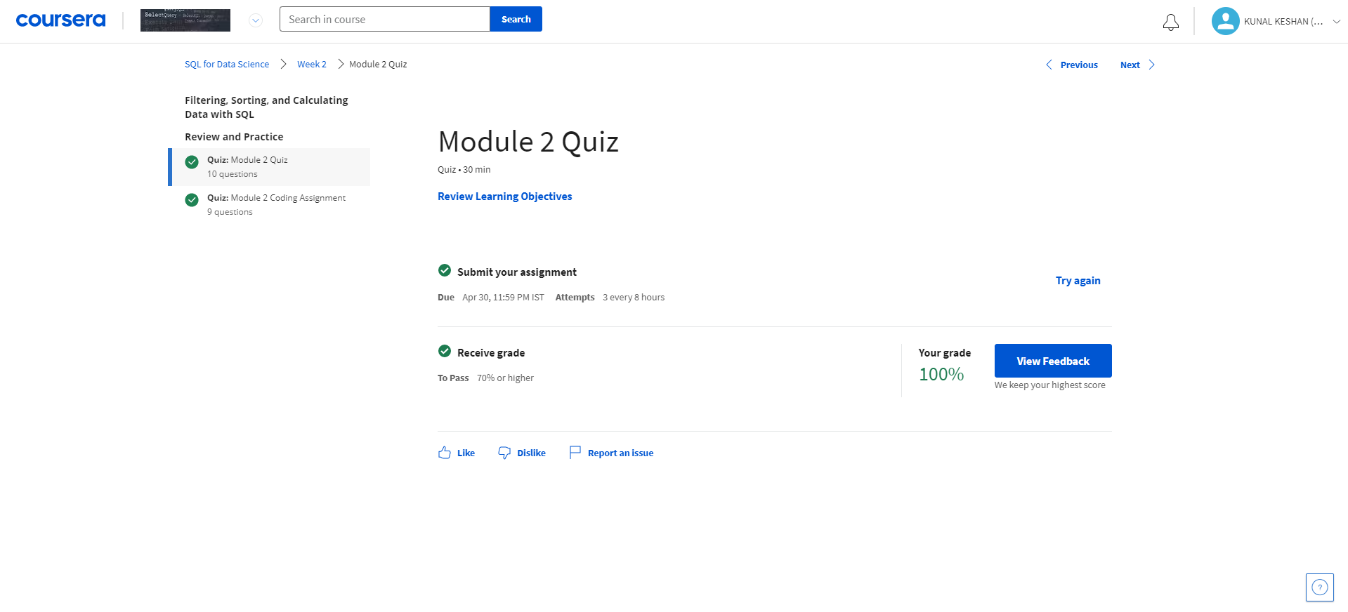
Module 2 Quiz

Slide 15
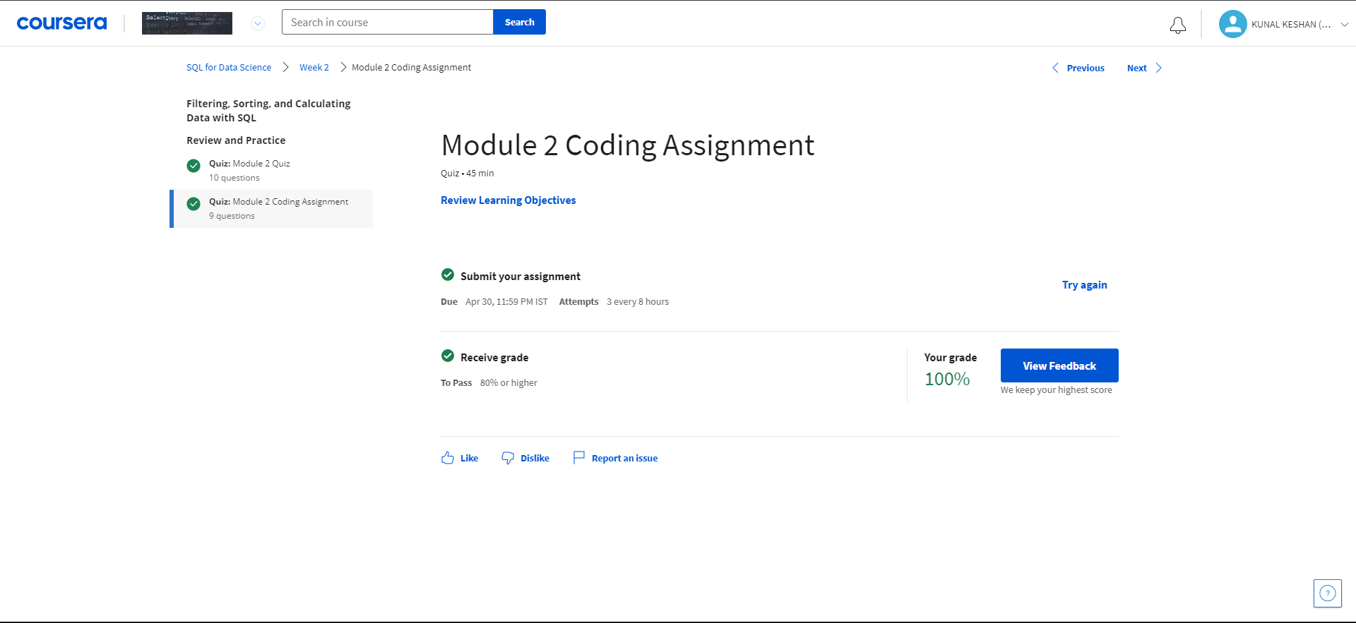
Module 2 coding assignment

Slide 16
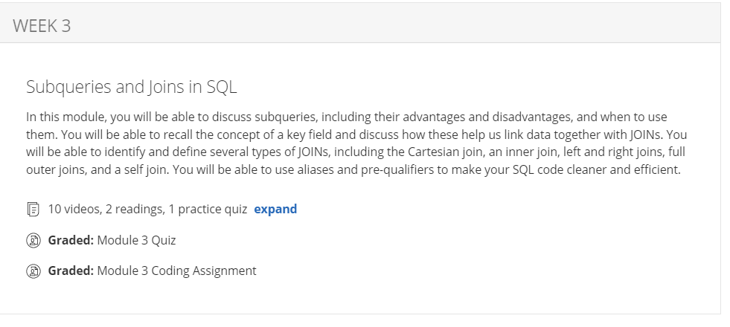
Week 3

Slide 17
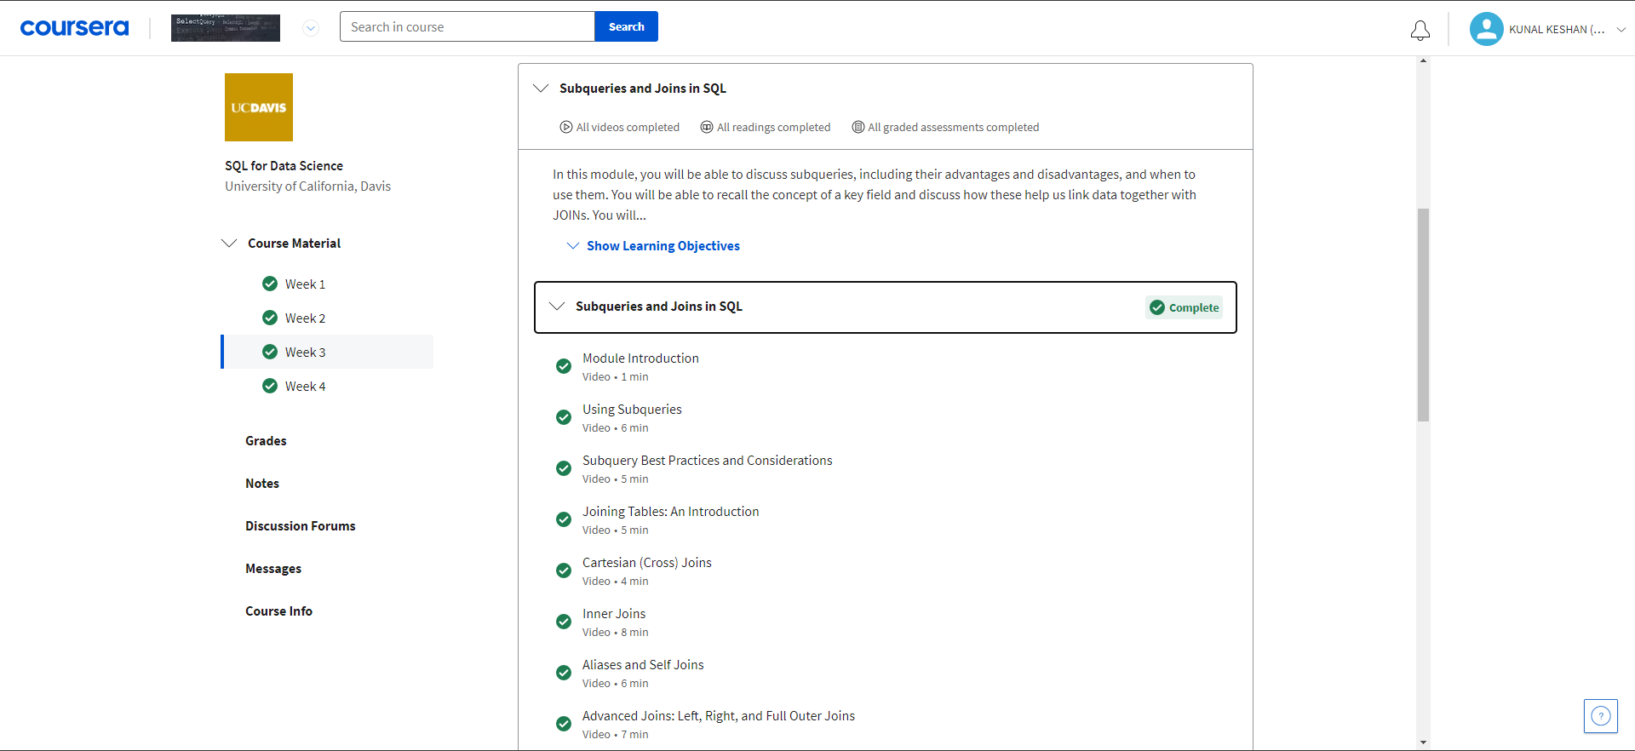
Week 3

Slide 18
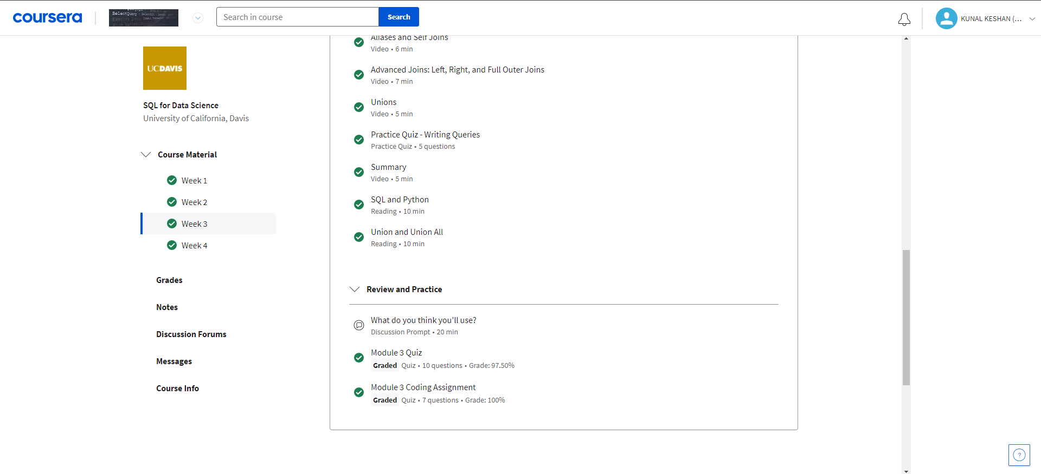
Week 3

Slide 19
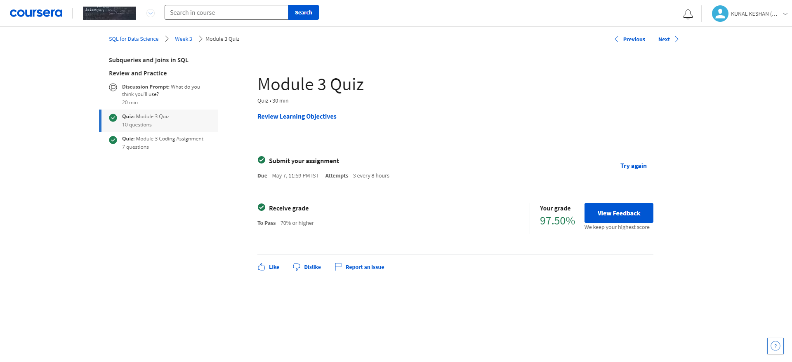
Module 3 Quiz

Slide 20
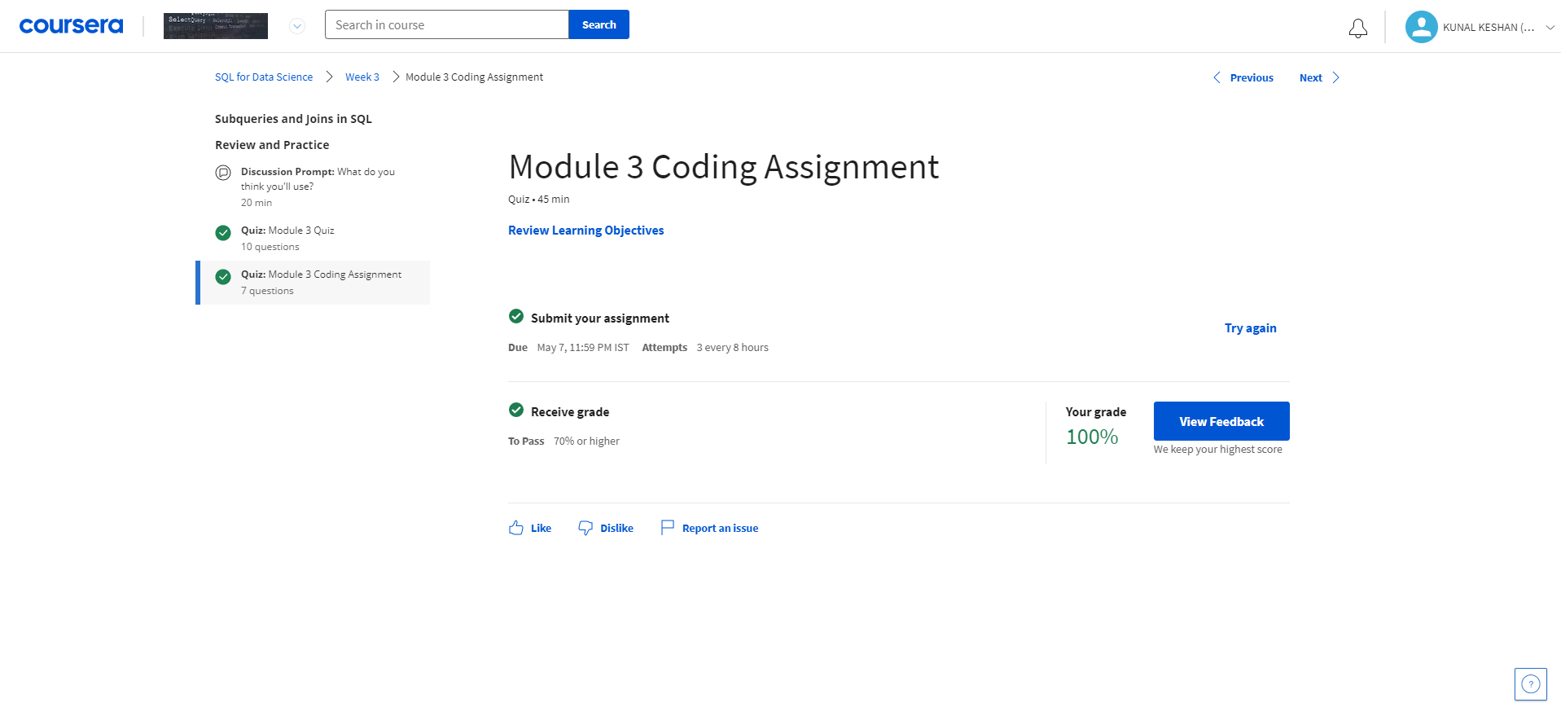
Module 3 Coding Assignment

Slide 21
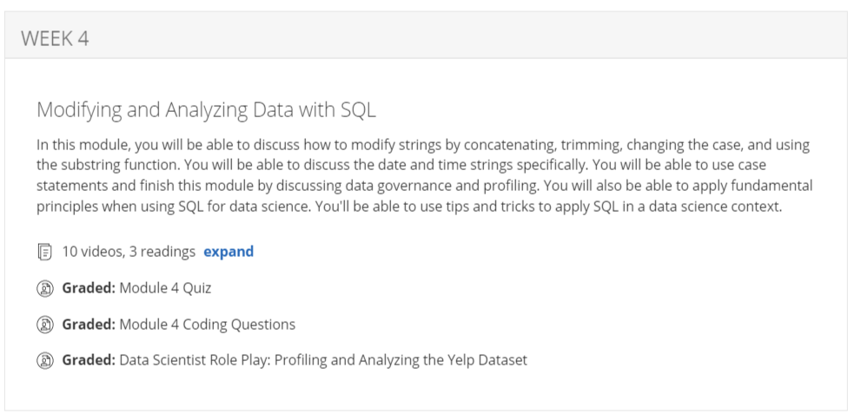
Week 4

Slide 22
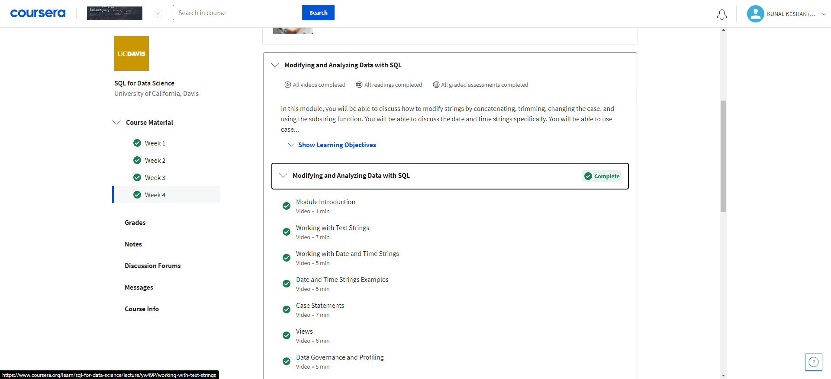
Week 4

Slide 23
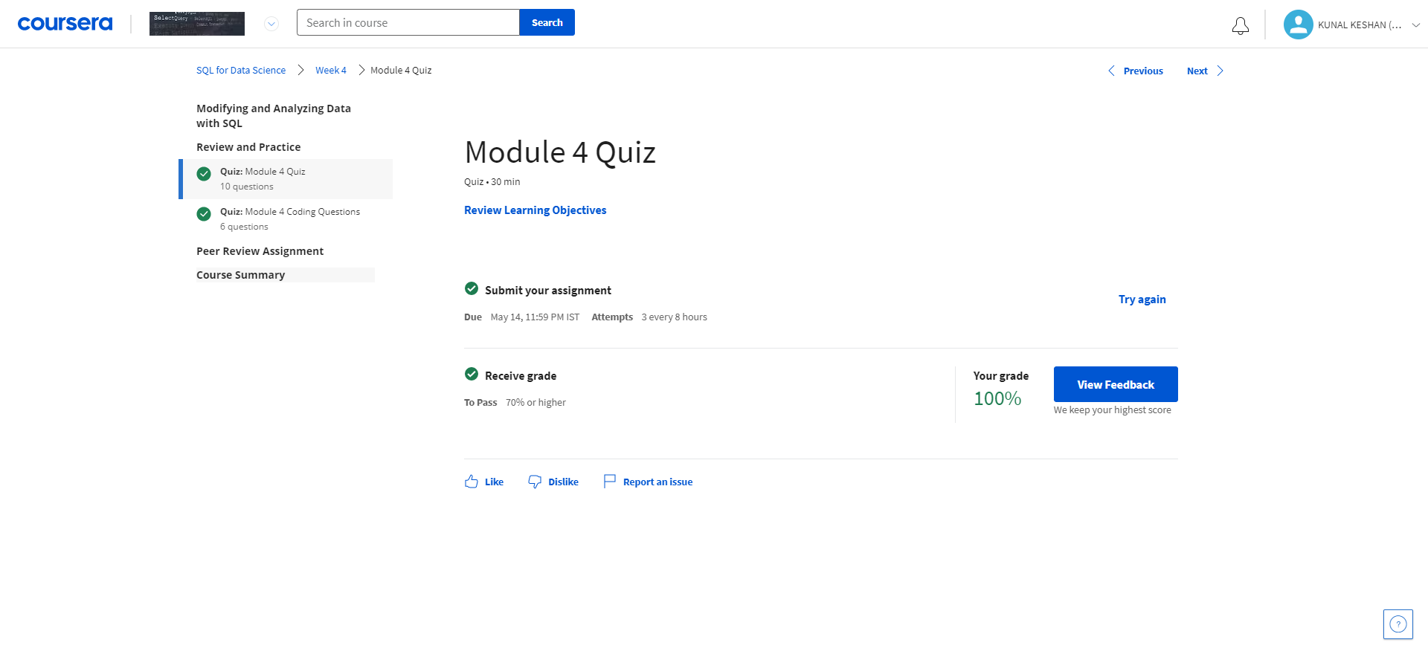
Module 4 Quiz

Slide 24
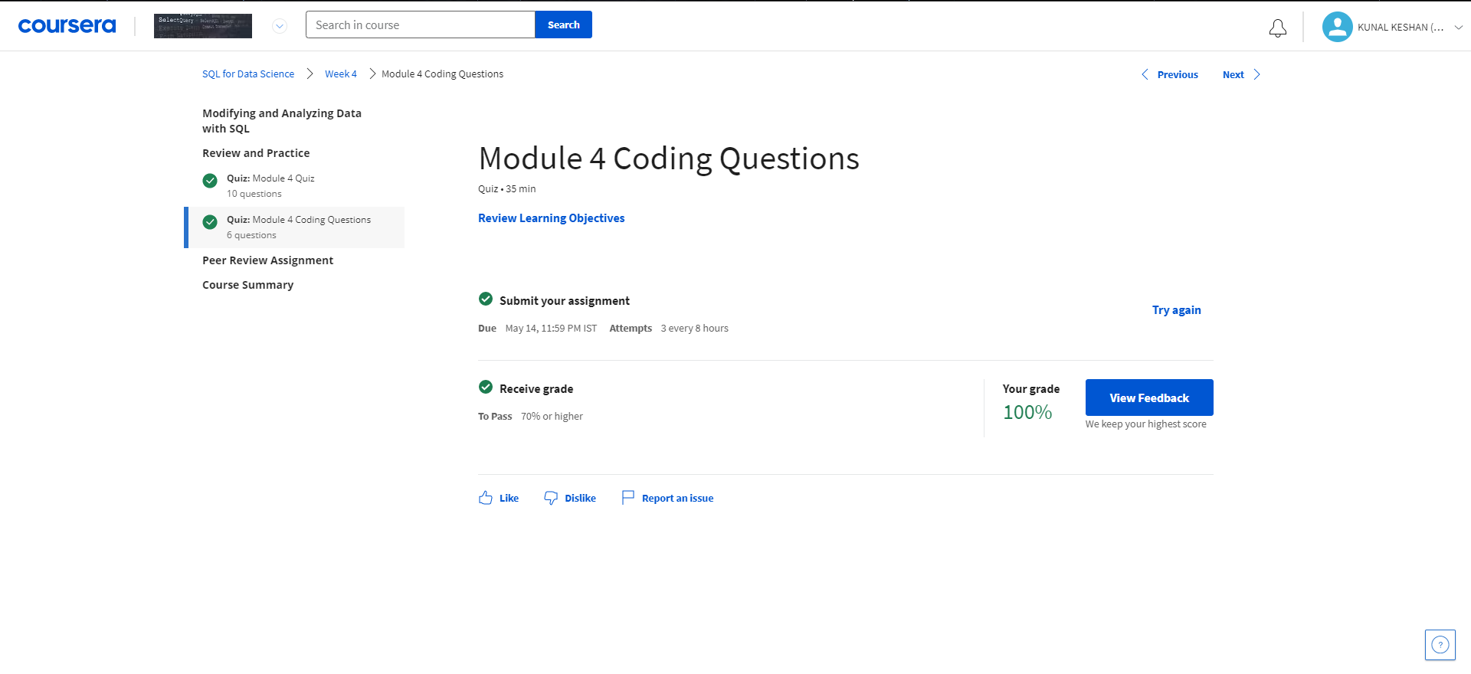
Module 4 Coding Assignment

Slide 25
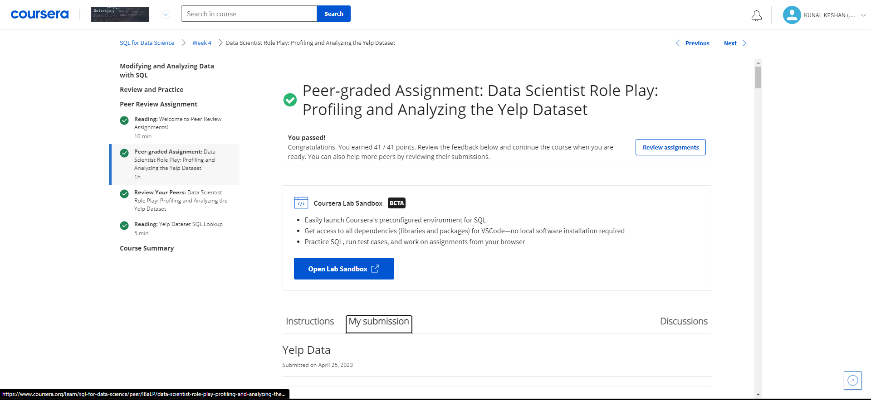
Peer Graded Assignment

Slide 26
Course Outcome
In this course, we went over an extraordinary amount of material. We started simple by going over standard SQL syntax, some standard databases terminology and how to write simple queries to help you select data from tables and work with it.
We moved on to discussing methods to filter and sort your data results by using common operators and clauses like where, like, order by, goodbye, and between. We also spent quite a bit of time talking about subqueries and different kinds of JOINS. We learned how to use case statements in order to help you categorize your data, and then we ended up going over some specific strategies to keep in mind when you're using SQL for data science purposes. Always remember, slowly do when writing your queries.

Slide 27
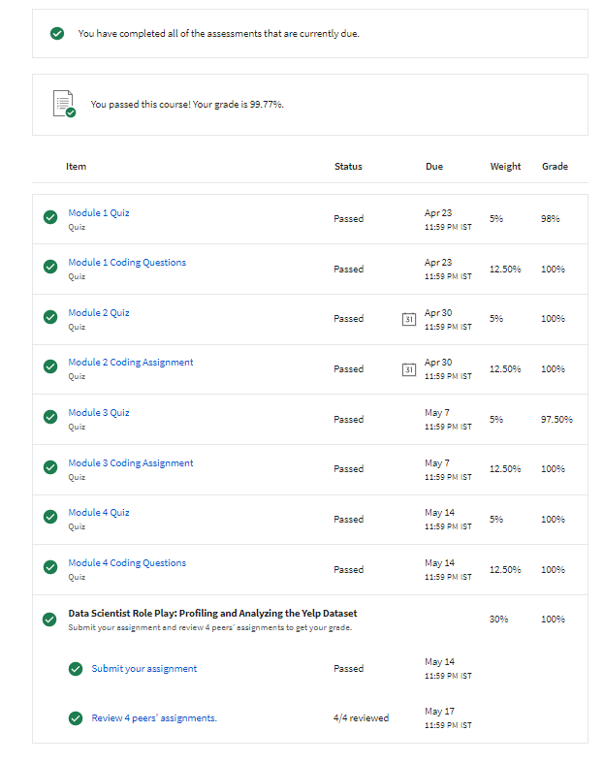
Course Grades

Slide 28
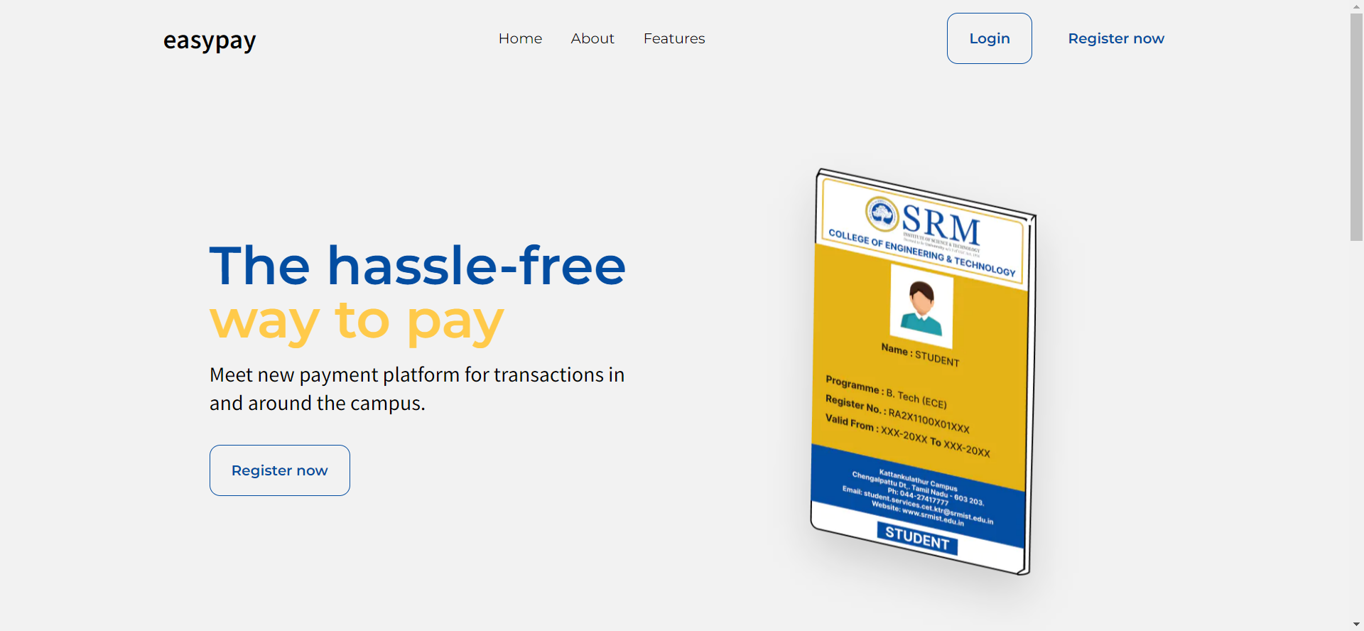
Project implementation
Used MySQL Database for the Hackathon Project in Smart Campus Hackathon.
https://easy-pay-srm.vercel.app/

Slide 29
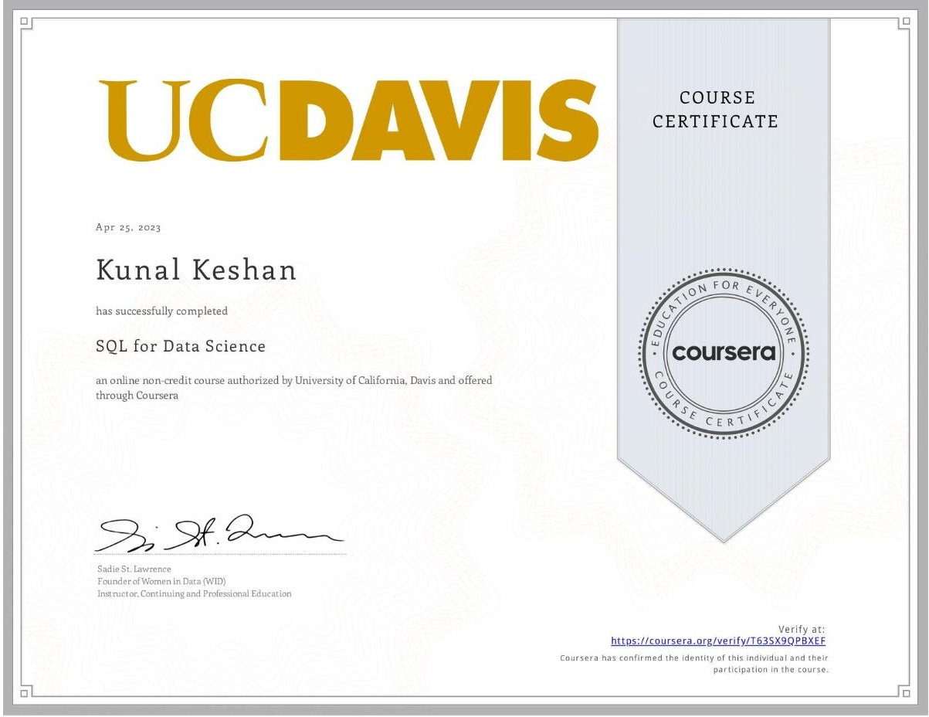
Proof of Completion

